Slide 1

Artificial Intelligence Techniques for
Short-Term Load Forecasting
CSE(AI)-B
GROUP 14
EEE & UID
GROUP MEMBER
VARSHITHA
MEERA NAMBIAR
YASHWANTH V
ROLL NO:
CB.SC.U4AIE24114
CB.SC.U4AIE24132
CB.SC.U4AIE24160

Slide 2

INTRODUCTION:
Load forecasting predicts future electricity demand using weather, season, and historical data to ensure efficient energy management.
Short-term forecasting estimates demand from a few hours to days ahead for better grid management.
Accurate predictions optimize power generation and distribution, reducing costs, preventing
energy waste, and enhancing efficiency.
Ensures grid stability and reliability by balancing supply with demand, preventing shortages or
overloads.
AI automation simplifies load forecasting, cutting down on manual work and allowing resources to
focus on more important tasks.

Slide 3
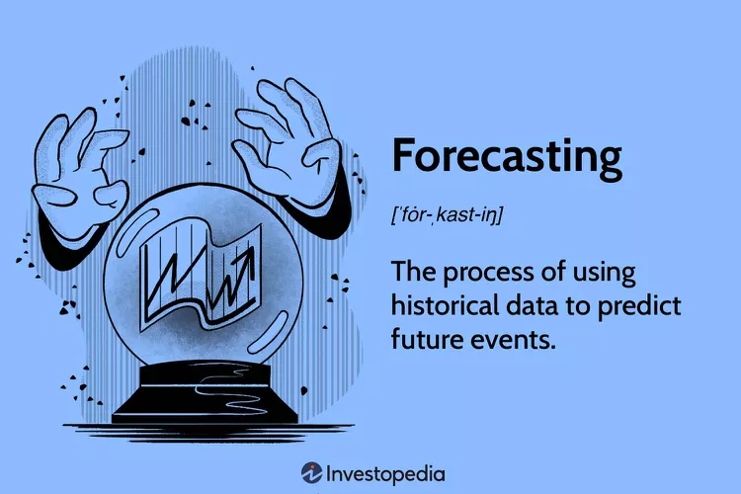
Problem Statement
Inaccurate Predictions: Traditional methods struggle to forecast short-term electricity demand accurately.
Sudden Demand Fluctuations: Rapid and unpredictable changes in consumption patterns make forecasting complex.
Operational Challenges: Inaccurate forecasts lead to power imbalances, higher costs, and inefficient resource allocation.
Need for Smarter Forecasting: A data-driven AI approach is essential to enhance prediction accuracy and optimize energy management.

Slide 4
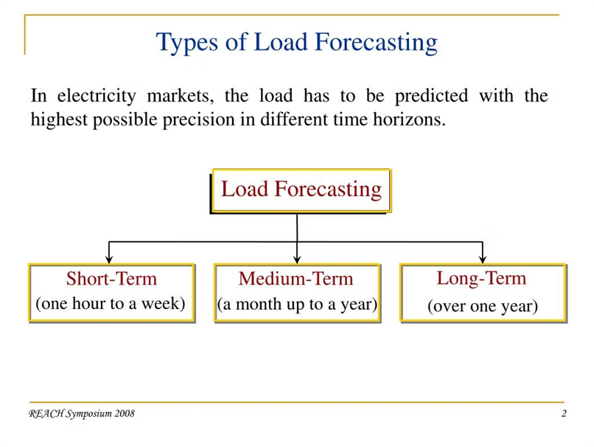
Objectives
To develop an AI-based load forecasting model using ANN and SVM.
To improve the accuracy of short-term electricity demand forecasts.
To compare the performance of ANN and SVM for load forecasting.
To help electric utilities make better decisions with accurate load forecasting.

Slide 5
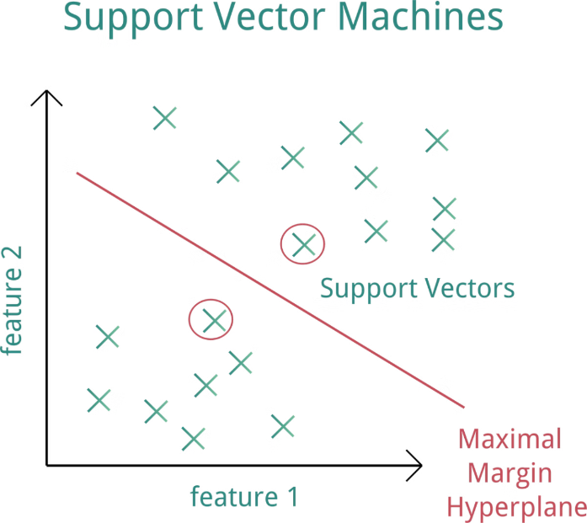
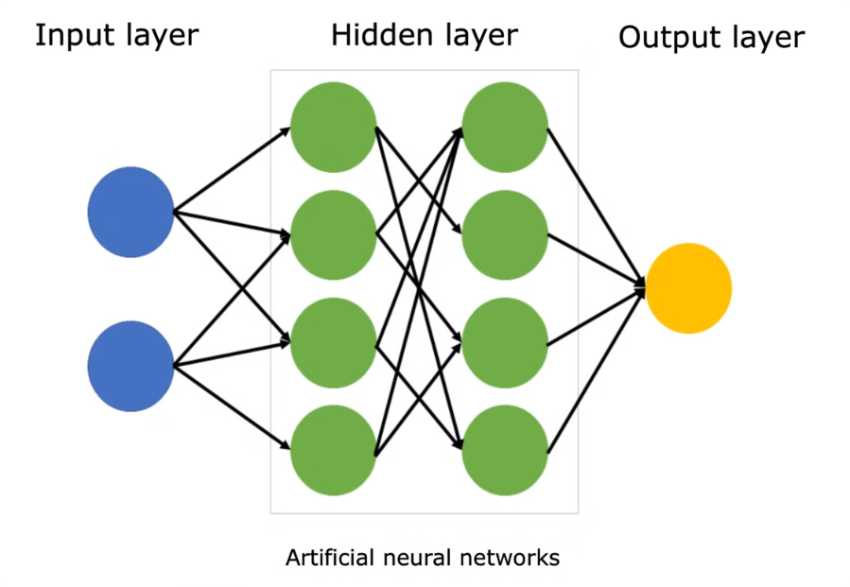
SUPPORT VECTOR MACHINE:
A supervised learning algorithm that finds the optimal hyperplane to separate different classes (for classification) or predict continuous values (for regression). Support Vector Regression (SVR) for regression tasks, with kernels like Linear, Polynomial, RBF (Radial Basis Function). Maximizes the margin between data points and the decision boundary using support vectors. Uses a kernel trick to handle non-linear data.
ARTIFICIAL NUERAL NETWORK:
A computational model inspired by biological neurons that learns patterns from data through interconnected layers of artificial neurons.
Feedforward Neural Network (FNN) with backpropagation for training. Can include multiple layers (deep learning).
Processes input through multiple layers (input → hidden → output), applies activation functions, and updates weights using backpropagation & gradient descent.

Slide 6


Data Collection
Data Preprocessing
Splitting the dataset for training and testing
Defining the Model
Train the Model
Evaluating

Slide 7
Methodology for Short-Term Electricity Load Forecasting
Data Preparation
Input data includes 4 weather features and 24 lagged nat_demand values.
Separate models are trained for each city: Tocumen, Santiago, and David.
Data is split into training (80%) and testing (20%) sets.
Standardization is applied using z-score normalization.
Model Training
Support Vector Machine (SVM) and Artificial Neural Network (ANN) models are trained for each city.
Trained models and normalization parameters are saved for future use.
SVM
Kernel Type: RBF (Radial Basis Function) kernel for capturing non-linear patterns in the data.
Hyperparameters:
C (regularization parameter): Controls trade-off between margin size and misclassification.
epsilon (for regression): Defines margin of tolerance for error.
Loss Function:
Uses ε-insensitive loss for regression.

Slide 8
ANN
Network Architecture:
Two hidden layers with 50 and 25 neurons were used
Activation functions-tansig (tangent sigmoid) activation for hidden layers and purelin (linear) activation for the output layer, suitable for regression-based load forecasting.
Training Algorithm:Backpropagation with optimization (e.g., Levenberg–Marquardt)
Loss Function:Mean Squared Error (MSE) or MAE during training
Epochs & Learning Rate:Number of training cycles and speed of learning.
Model Evaluation
Models are evaluated on the testing set using:
MAE (Mean Absolute Error)-Measures how much predictions deviate from actual values.
RMSE (Root Mean Squared Error)-square root of the average of squared differences between predicted and actual values. It gives a higher penalty to large errors compared to MAE.
R² Score (Coefficient of Determination)-proportion of variance in the actual data that is explained by the model. It shows how well the predictions fit the true data.
Comparative bar charts are generated for visual performance analysis.

Slide 9
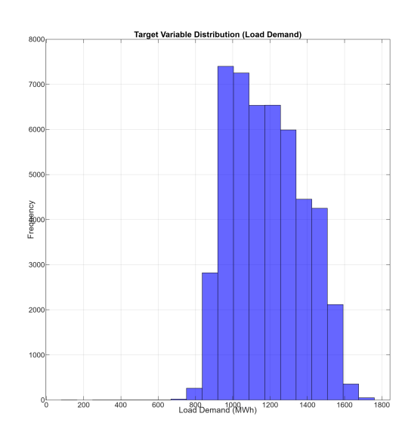
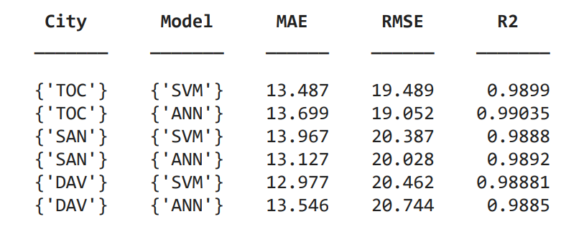
Results:
Graph: Load Demand Distribution (Histogram)
Plots how often different Load Demand (MWh) values appear in the dataset.
X-axis → Load Demand (MWh), Y-axis → Frequency (how many times it occurs).
Model Performance:
Observation: All models achieved very high R² (> 0.98), indicating strong prediction accuracy.

Slide 10
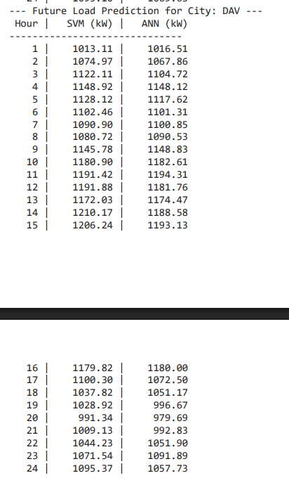
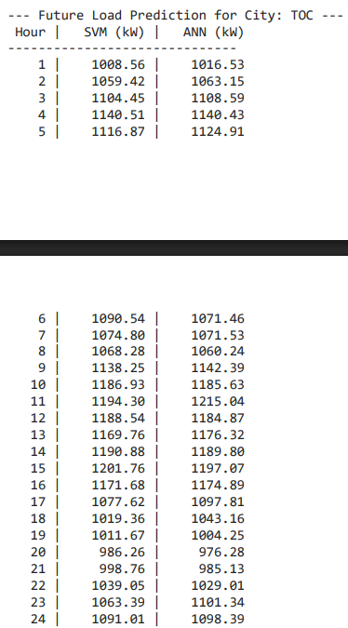
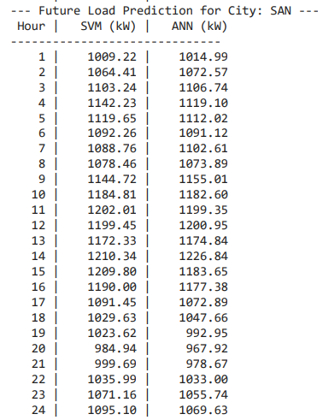
24-Hour Ahead Forecasting
Models trained using weather variables and lagged demand showed strong generalization on unseen data.
ANN was more robust in handling fluctuations or anomalies in demand patterns.

Slide 11
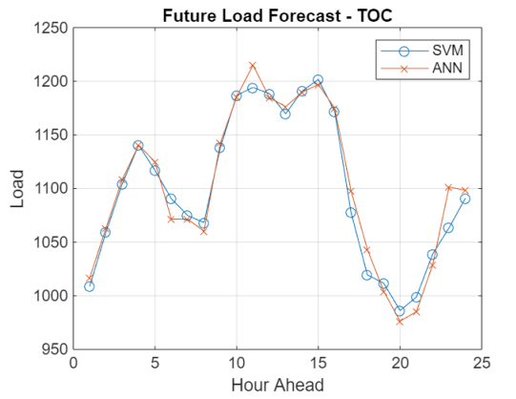
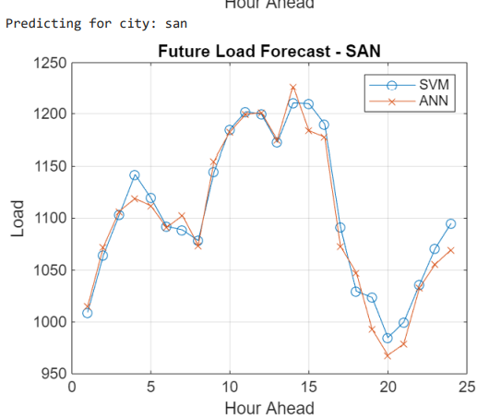
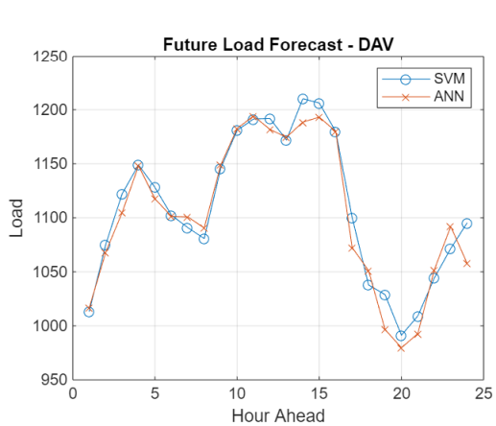
CONCLUSION
Both SVM and ANN models are effective for short-term load forecasting.
ANN is slightly more stable, but SVM gives competitive and reliable results with less training time.

Slide 12
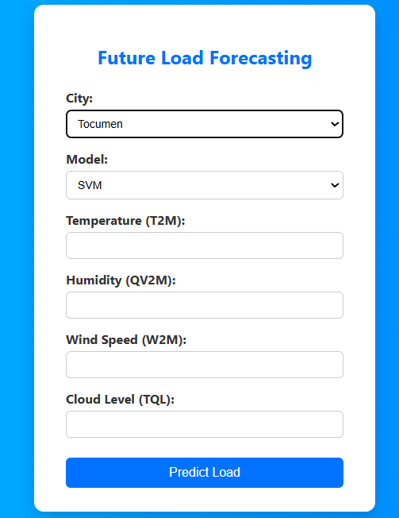
User Interface Design
A simple webpage lets users input data and get predictions instantly.
User will select the desired inputs and then it will predict the next 24 hours future prediction.
User (HTML Form) → Python (Flask App) → MATLAB (Prediction) → Python → HTML (Results)

Slide 13
Challenges and Limitations of AI-based Load Forecasting
Data Quality
1
AI models need accurate and complete data to make correct forecasts. If the data is poor or missing, it can cause wrong and biased predictions.
Overfitting
2
AI models can become too focused on the training data, making it hard for them to predict accurately when faced with new data.
Interpretability
3
AI models can become too focused on the training data, making it hard for them to predict accurately when faced with new data.

Slide 14

Future Scope
1
2
Integration
Advancements
Future research will focus on integrating AI with other technologies, such as smart grids and demand response, for improved load management.
The development of new and advanced AI techniques, such as deep learning, holds promise for enhancing load forecasting capabilities.
3
Benefits
By leveraging AI, electric utilities can achieve greater operational efficiency, ensure grid reliability, and optimize energy resources, benefitting both the industry and consumers.

Slide 15
THANKYOU...

